Slide 1
Software Engineering - Module I
Introduction to Software Engineering and Software Process

Slide 2
SOFTWARE AND SOFTWARE ENGINEERING
INTRODUCTION TO SOFTWARE ENGINEERING AND SOFTWARE PROCESS
The changing Nature of Software:
Software delivers the most important product of our time—information. Some of the functions of Software are:-
It transforms personal data so that the data can be more useful in a local context;
It manages business information to enhance competitiveness;
It provides a gateway to worldwide information networks and provides the means for acquiring information in all of its forms.

Slide 3
Key Characteristics of Software:
Intangibility
Software doesn’t wear out
Software is engineered not manufactured
Maintenance
complexity

Slide 4
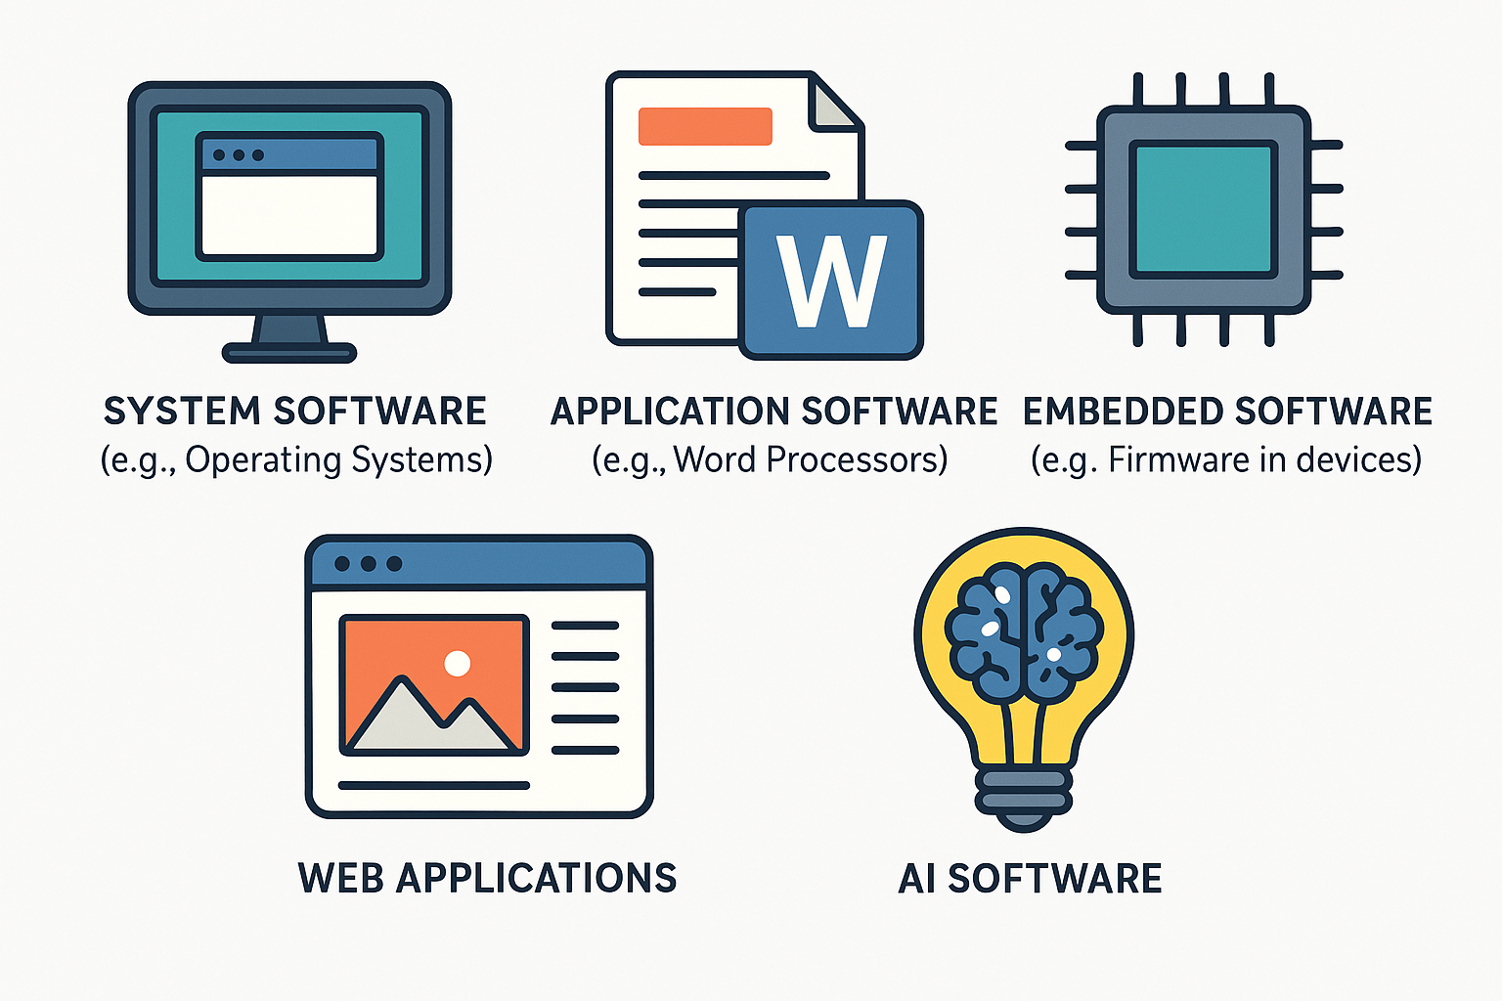
SOFTWARE AND SOFTWARE ENGINEERING
Types of Software

Slide 5
a. System Software
It is designed to operate, manage, and support the computer hardware and system resources.
It runs in the background and manages system-level functions.
Essential for the basic functioning of a computer.
Directly interacts with hardware
Examples: OS, Device Drivers, Utilities

Slide 6
b. Application Software
It is designed to help users perform specific tasks or solve particular problems.
It runs on top of system software.
Created for end-users to carry out productivity tasks.
Examples: MS Word, Media Players, Browsers

Slide 7
c. Embedded System Software
It is specialized software designed to run on embedded systems
Runs on non-general-purpose computers.
Controls hardware-specific functions.
Stored in firmware or ROM.
Examples: ECU, Smart watches, Smart TVS

Slide 8
d. Web-Based Software
Software that is hosted on web servers and accessed via web browsers over the internet.
Why it is classified as Web-Based Software:
Operates online without local installation.
Depends on client-server architecture.
Examples:
Google Docs: Online document editing.

Slide 9
e. AI Software
Software that exhibits intelligent behavior and mimics human cognitive functions like learning, problem-solving, and decision-making.
Why it is classified as AI Software:
Implements algorithms that allow machines to learn and adapt.
Based on artificial intelligence technologies like machine learning, NLP, and computer vision.
Examples:
Chatbots (e.g., ChatGPT): Natural language interaction.

Slide 10
1.1. What is Software Engineering?
Software Engineering can be defined as:
“The application of a systematic, disciplined, quantifiable approach to the development, operation, and maintenance of software”. - IEEE Standard Glossary of Software Engineering Terminology
Core Objectives of Software Engineering:
Deliver software that meets user needs and expectations.
Maintainability: Ability to modify software easily when requirements change.
Efficiency and performance.

Slide 11
1.2. The Software Process
It is a framework that includes the structured set of activities required to build software systems.
It consists of:
Communication: gathering requirements and understanding the needs of the stakeholders through interaction and feedback.
Planning: Estimation of costs, resources, timelines, and scheduling tasks for development.
Modeling: Creating abstract representations of the software
Construction: Coding the software based on design models.
Deployment: Delivery of the software to the user and subsequent maintenance based on feedback and error reports.

Slide 12
Software Engineering Practices
Modern software engineering practice includes a combination of methodologies, tools, and workflows to deliver effective software solutions.
Best Practices Include:
Requirement Analysis: Understanding customer needs through techniques like interviews, use cases, and prototyping.
Software Design: Architectural and detailed design to address system requirements.
Coding Standards: Writing consistent, readable, and reusable code following established standards.
Testing: Systematic testing at various stages – unit, integration, system, and acceptance testing.

Slide 13
Software Myths
There are many myths surrounding software development, often leading to miscommunication and project failures.
Management Myths:
‘We have the best tools, so we don’t need a defined process.'
'Adding more developers will solve our deadline issues’.
Customer Myths:
‘Changing requirements is easy and inexpensive.'
Practitioner Myths:
Once a program works, the job is done.
'Documentation is unnecessary because the code explains itself.

Slide 14
PROCESS MODELS
Advantages of Software Process Framework
Increased Productivity
Consistent Quality
Reduced Development Time
Better Maintainability
Enhanced Security

Slide 15
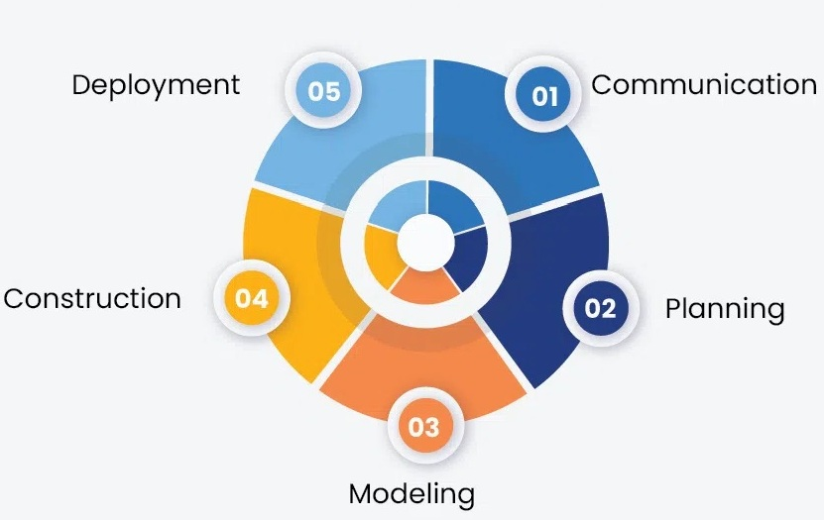
2.1. Generic Software Process Model
The five framework activities are:

Slide 16
1. Communication
Purpose: Understand what the customer needs.
Typical activities:
Requirement elicitation through interviews, questionnaires, or observation
Identifying stakeholders and their expectations
Documenting and validating requirements
Creating Software Requirement Specification (SRS)

Slide 17
2. Planning
Planning means thinking before doing.
Purpose: Create a roadmap for software development.
Typical activities:
Estimating effort, time, and cost
Resource allocation (team members, hardware, software tools)
Risk analysis and mitigation strategies

Slide 18
3. Modeling
Purpose: Convert requirements into a blueprint for development.
Typical activities:
Creating data models (ER diagrams)
Designing architectural models (high-level structure)
Designing user interface (UI) layouts
Defining algorithms and workflows

Slide 19
4. Construction
Purpose: Build and verify the actual software.
Description: "The software is coded based on the design documents and then tested to ensure it meets requirements".
Typical activities:
Writing source code in the chosen programming language
Unit testing (checking individual components)
Integration testing (verifying module interaction)

Slide 20
5. Deployment
Purpose: Deliver the software to the end-users and provide ongoing support.
Typical activities:
Deployment to production servers or app stores
User training and documentation
Post-deployment support
Corrective, adaptive, and perfective maintenance

Slide 21
Process Assessment and Improvement
1. Process Assessment
Definition: "A structured evaluation of an organization’s software development processes to determine their current state of maturity, capability, and effectiveness".
Purpose:
Identify strengths and weaknesses in current processes
Compare processes against industry standards and best practices
Provide a baseline for improvement efforts
Key Steps in Process Assessment:

Slide 22
2. Process Improvement
Definition: A systematic effort to enhance the effectiveness, efficiency, and adaptability of software processes, based on assessment results.
Goals:
Reduce defects and rework
Improve productivity and predictability
Increase customer satisfaction
Lower development costs

Slide 23
3. Common Process Improvement Models
CMMI: Focuses on five maturity levels, from Initial (ad-hoc) to Optimizing (continuous improvement).
ISO/IEC 15504 (SPICE): Rates processes on a capability scale (Level 0 to Level 5).
Six Sigma: Reduces process variation and defects using statistical methods.
Lean Software Development: Eliminates waste and improves efficiency.
Agile Process Improvement: Uses iterative feedback loops and retrospectives.

Slide 24
4. Process Improvement Cycle
Often follows the PDCA (Plan-Do-Check-Act) or DMAIC (Define-Measure-Analyze-Improve-Control) cycle.
Plan – Identify areas for improvement and set goals
Do – Implement changes in a controlled environment
Check – Measure results against goals
Act – Standardize successful changes and repeat the cycle

Slide 25
5. Benefits of Process Assessment & Improvement
Higher quality software
Predictable delivery times
Lower development costs
Better team coordination
Continuous learning and adaptation

Slide 26
6. Example
A company performs a CMMI-based assessment and finds:
Lack of formal requirement management
Inconsistent testing practices
Improvements Implemented:
Introduced a formal SRS (Software Requirement Specification) process
Standardized test case documentation and review

Slide 27
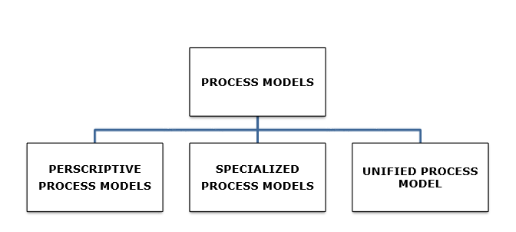
Process Models
A process model for software engineering is chosen based on the nature of the project and application

Slide 28
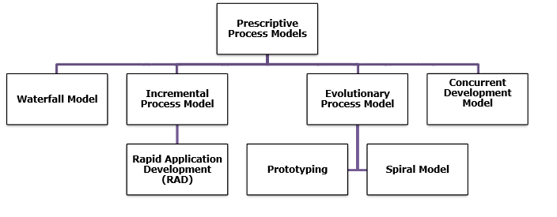
PERSCRIPTIVE PROCESS MODELS
Prescriptive Process Models defines a distinct set of activities, actions, tasks, milestones, and work products that are required to engineer high-quality software.

Slide 29
PERSCRIPTIVE PROCESS MODELS
Process elements are:
Framework activities
Software engineering actions
Tasks
Work Products
Quality Assurance

Slide 30
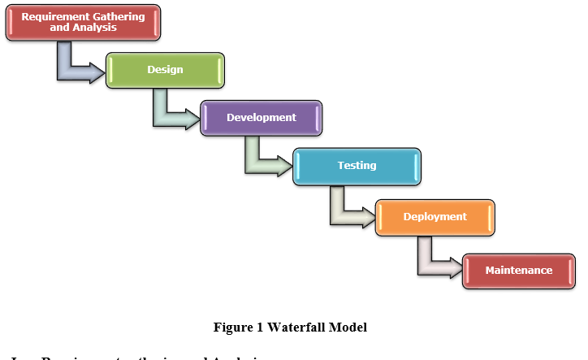
PERSCRIPTIVE PROCESS MODELS
1. Waterfall Model

Slide 31
PERSCRIPTIVE PROCESS MODELS
1. Waterfall Model
Features
Sequential Approach
Document-Driven
Quality Control
Rigorous Planning
Importance of Waterfall Model
Clarity and Simplicity
Clearly Defined Phases
Documentation
Stability in Requirements
Resource Optimization
Relevance for Small Projects

Slide 32
PERSCRIPTIVE PROCESS MODELS
Advantages of Waterfall Model
Easy to Understand
Individual Processing
Properly Defined
Clear Milestones
Properly Documented
Reinforces Good Habits

Slide 33
PERSCRIPTIVE PROCESS MODELS
Disadvantages of Waterfall Model
No Feedback Path
Difficult to accommodate Change Requests
No Overlapping of Phases
Limited Flexibility
Limited Stakeholder Involvement
Late Defect Detection
Lengthy Development Cycle

Slide 34
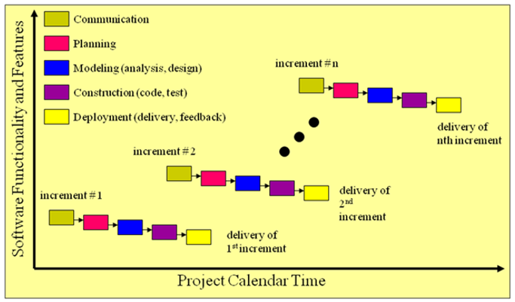
PERSCRIPTIVE PROCESS MODELS
2. Incremental Process Model
Incremental Process Model combines elements of the waterfall model applied in an iterative fashion.
Each linear sequence produces deliverable “increments” of the software

Slide 35
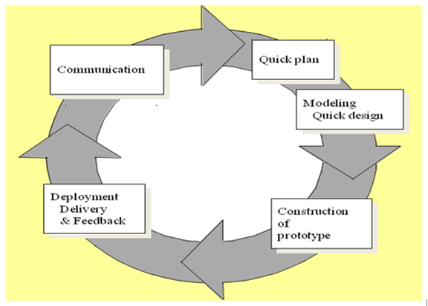
PERSCRIPTIVE PROCESS MODELS
3. Prototyping Model
Is used when Customer defines a set of general objectives but does not identify detailed requirements for functions and features

Slide 36
PERSCRIPTIVE PROCESS MODELS
3. Prototyping Model
Advantages of Prototyping Model
The customers get to see the partial product early in the life cycle
New requirements can be easily accommodated
Missing functionalities can be easily figured out
Errors can be detected much earlier
Flexibility in design
Early feedback from customers and stakeholders

Slide 37
PERSCRIPTIVE PROCESS MODELS
3. Prototyping Model
Disadvantages of Prototyping Model
Costly concerning time as well as money
There may be too much variation in requirements
Poor Documentation
Developers in a hurry to build prototypes may end up with sub-optimal solutions

Slide 38
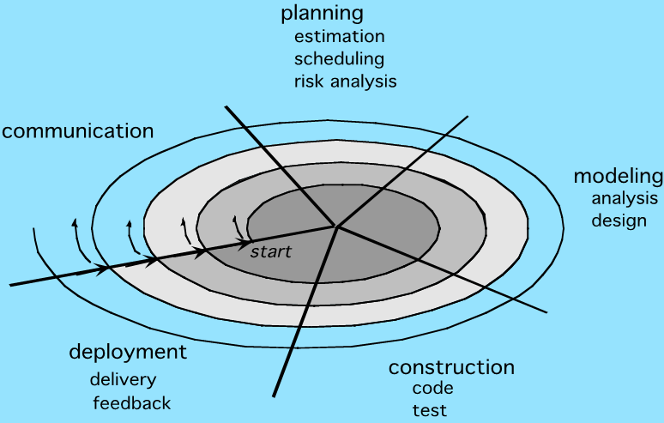
PERSCRIPTIVE PROCESS MODELS
4. Spiral Model
It is a well-known and widely used software development model
Spiral model referred as a "meta model."

Slide 39
PERSCRIPTIVE PROCESS MODELS
4. Spiral Model
Benefits of using Spiral Model
The spiral model is a realistic approach to the development of large-scale systems and software.
Spiral model uses prototyping as a risk reduction mechanism
It maintains the systematic stepwise approach
Direct consideration of technical risks at all stages of the project

Slide 40
PERSCRIPTIVE PROCESS MODELS
4. Spiral Model
Applications of Spiral Models
The Spiral Model is well-suited for large, complex, and high-risk projects
Examples
Developing operating systems like Microsoft Windows
Game development
Creating complex systems like Intelligent Transportation Systems.
E-commerce platforms, electronic health record systems, and mobile application development.

Slide 41
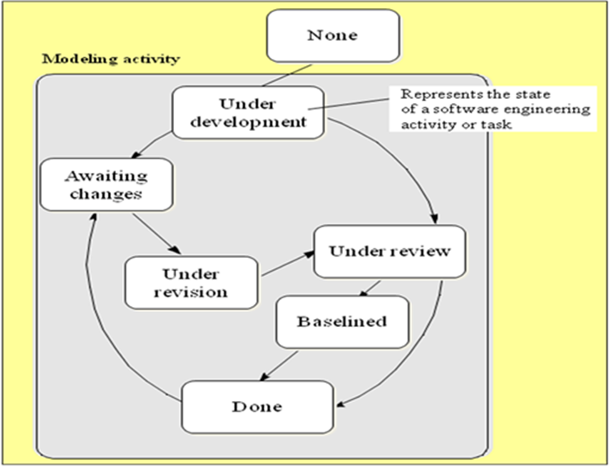
PERSCRIPTIVE PROCESS MODELS
5. Concurrent Model
All activities exist concurrently but reside in different states.
It defines a series of events that will trigger transitions from state to states.
This one is applicable to all types of s/w development. It defines a network of activities.

Slide 42
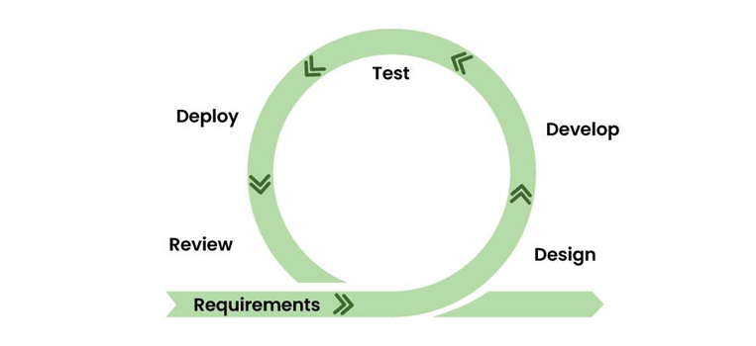
PERSCRIPTIVE PROCESS MODELS
6. Agile Model
Agile Development Model is a combination of iterative and incremental models
Focus on process adaptability and customer satisfaction.
This was created mainly to make changes in the middle of software development so that the software project can be completed quickly.

Slide 43
PERSCRIPTIVE PROCESS MODELS
7. Specialized Process Models
There are three kinds of Specialized Process Models are used:-
Component-Based Development
The Formal Methods Model
Aspect-Oriented Software Development

Slide 44
Component-Based Development
Commercial off-the-shelf (COTS) software components can be used.
Components should have well-defined interfaces.
Incorporates many of the characteristics of the spiral model.
Evolutionary in nature.
Candidate components should be identified first.
Components can be designed as either conventional software modules or object-oriented classes or packages of classes

Slide 45
The Formal Methods Model
Encompasses a set of activities that leads to formal mathematical specification of computer software
Ambiguity, incompleteness, and inconsistency can be discovered and corrected more easily
Cleanroom Software Engineering is a variation of the Formal Methods Model.
Drawbacks of Formal Methods Model:-
The development of formal models is currently quite time-consuming and expensive.
Extensive training is required.

Slide 46
Aspect-Oriented Software Development
Aspect Oriented software development (AOSD)—provides a process and methodological approach for defining, specifying, designing, and constructing aspects.
It is likely that AOSD will adopt characteristics of both the spiral and concurrent process models.

Slide 47
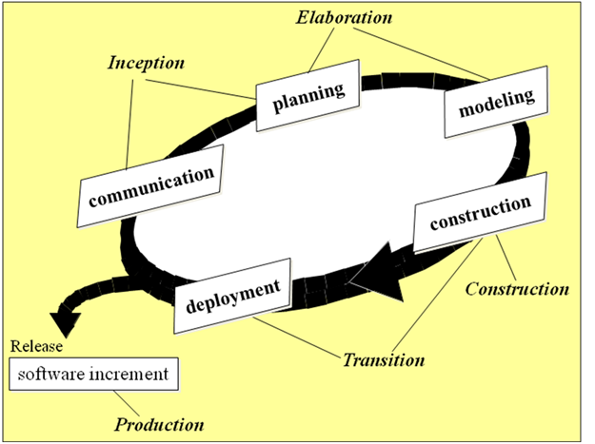
8. Unified Process Model
Unified Process Model is a “use-case driven, architecture-centric, iterative and incremental” software process
UP is a framework for object-oriented software engineering using UML

Slide 48
8. Unified Process Model
Figure (i) shows different Phases of Unified Process:-
Inception
Elaboration
Construction
Transition
Production

Slide 49
Unified Process Work Products
Inception
Vision document
Initial use-case model
Elaboration
Analysis model
design model
Construction
Implementation model,
Deployment model
Test model
Transition
Delivered software
Beta test reports
General user feedback

Slide 50
Any Questions ?!!

